Slide 1
CSS Forms

Slide 2
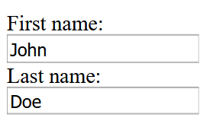
Remember that we created a form using HTML…?

Slide 3
Well…
It’s boring and the user experience is not very good…
Now, we’ll utilise what we have learn to modify a form using CSS!

Slide 4
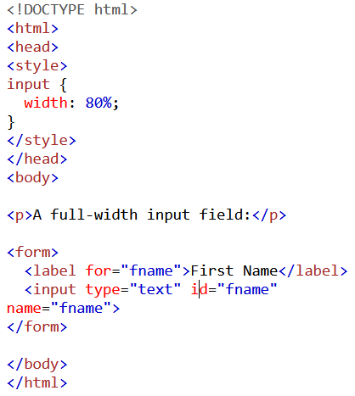
Adjusting width of inputs
Notes:
Changing width will affect the width of the text box.
Applies to all input types e.g.:
input[type=text] - will only select text fields
input[type=password] - will only select password fields
input[type=number] - will only select number fields
etc..

Slide 5
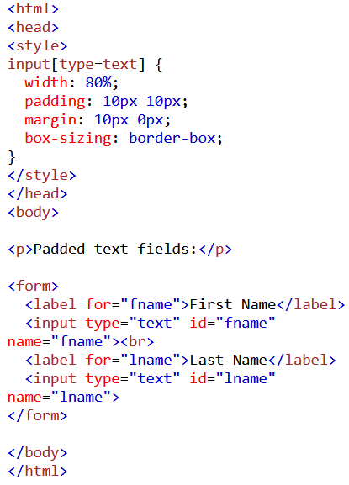
Padding to increase space within input box
Notes:
As per title

Slide 6
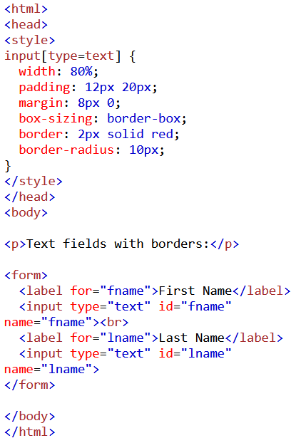
Bordered input box
What if we only want a bottom border?
Notes:
input[type=text] { border: none; border-bottom: 2px solid red; }

Slide 7
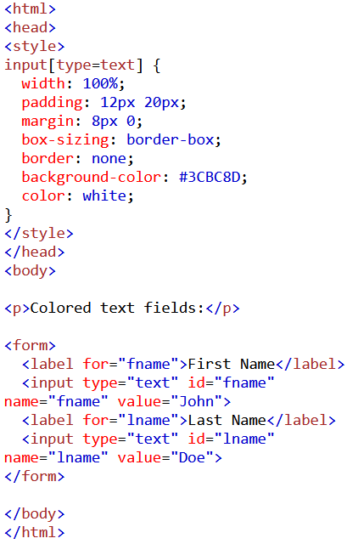
Changing the background colour of input box

Slide 8
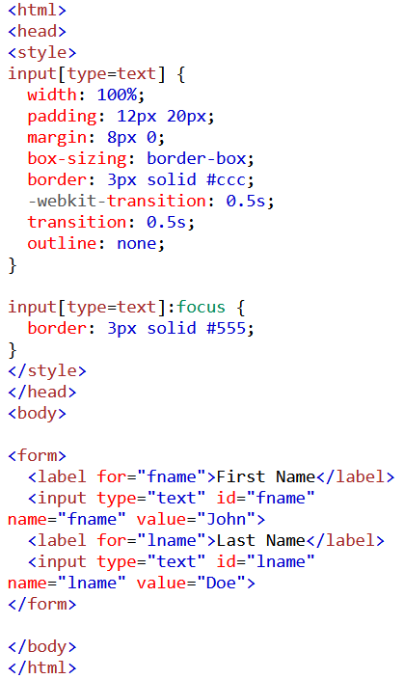
:focus selector
What if I want to change the colour of the background instead?
Notes:
input[type=text] { background-color: #3CBC8D; color: white; }

Slide 9
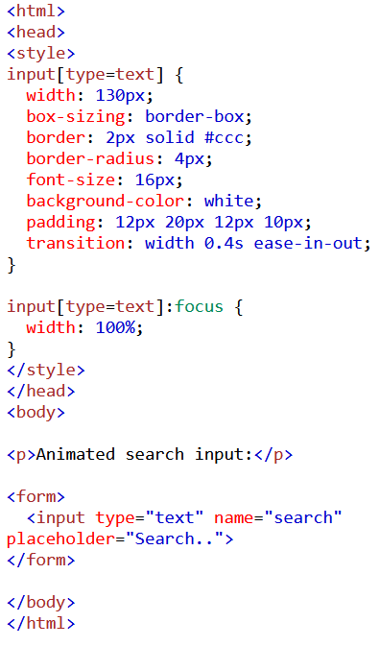
Animation using transition
How can we utilise animation together with transition?
Notes:
Placeholder disappears when a user types in it.

Slide 10
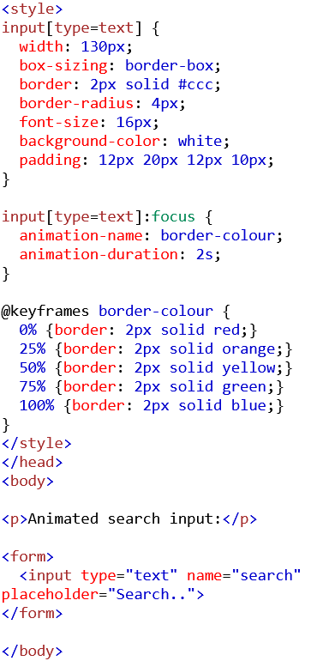
How can we utilise animation together with transition?
Notes:
Placeholder disappears when a user types in it.

Slide 11
Try it yourself!
Implement a form that takes “first name”, “last name”, “country” and a text box for “short description”
Implement with animation using @keyframes!

